Slide 1

Plant Disease Identification through Leaf Pattern by Multimodal Data Fusion and Explainable AI
CSE - 713
Task -03
Team - 07

Slide 2
Team Information
Mosa. Rabeya
ID: 23266013
Ishrat Jahan Easha
ID: 23266038
Alvi Anowar
ID: 23366031
Md Alkawser Rahman ID: 23366049
Team - 07

Slide 3
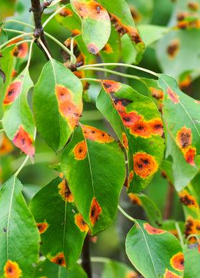
Introduction
Plant diseases hinder global food production due to inefficient traditional detection methods.
The project explores multimodal data fusion and Explainable AI for improved disease detection.
The goal is to create an AI system for early, precise identification of plant diseases through leaf pattern analysis.

Slide 4
Background
References | Data Collection | Proposed Model | Best accuracy
Cherra et al. (2022) | 20,639 images | CNN | 97.70%
Suresh et al. (2020) | 54,305 images | Faster R-CNN | 70.82% (scab), 94.97% (cedar apple rust)
Chohan et al.(2020) | Online | CNN | 98.3%
Guo et al. (2020) | Online | RPN, Chan-Vese | 83.57%
Ramesh et al.(2018) | Online | Random Forest | 70.14%

Slide 5
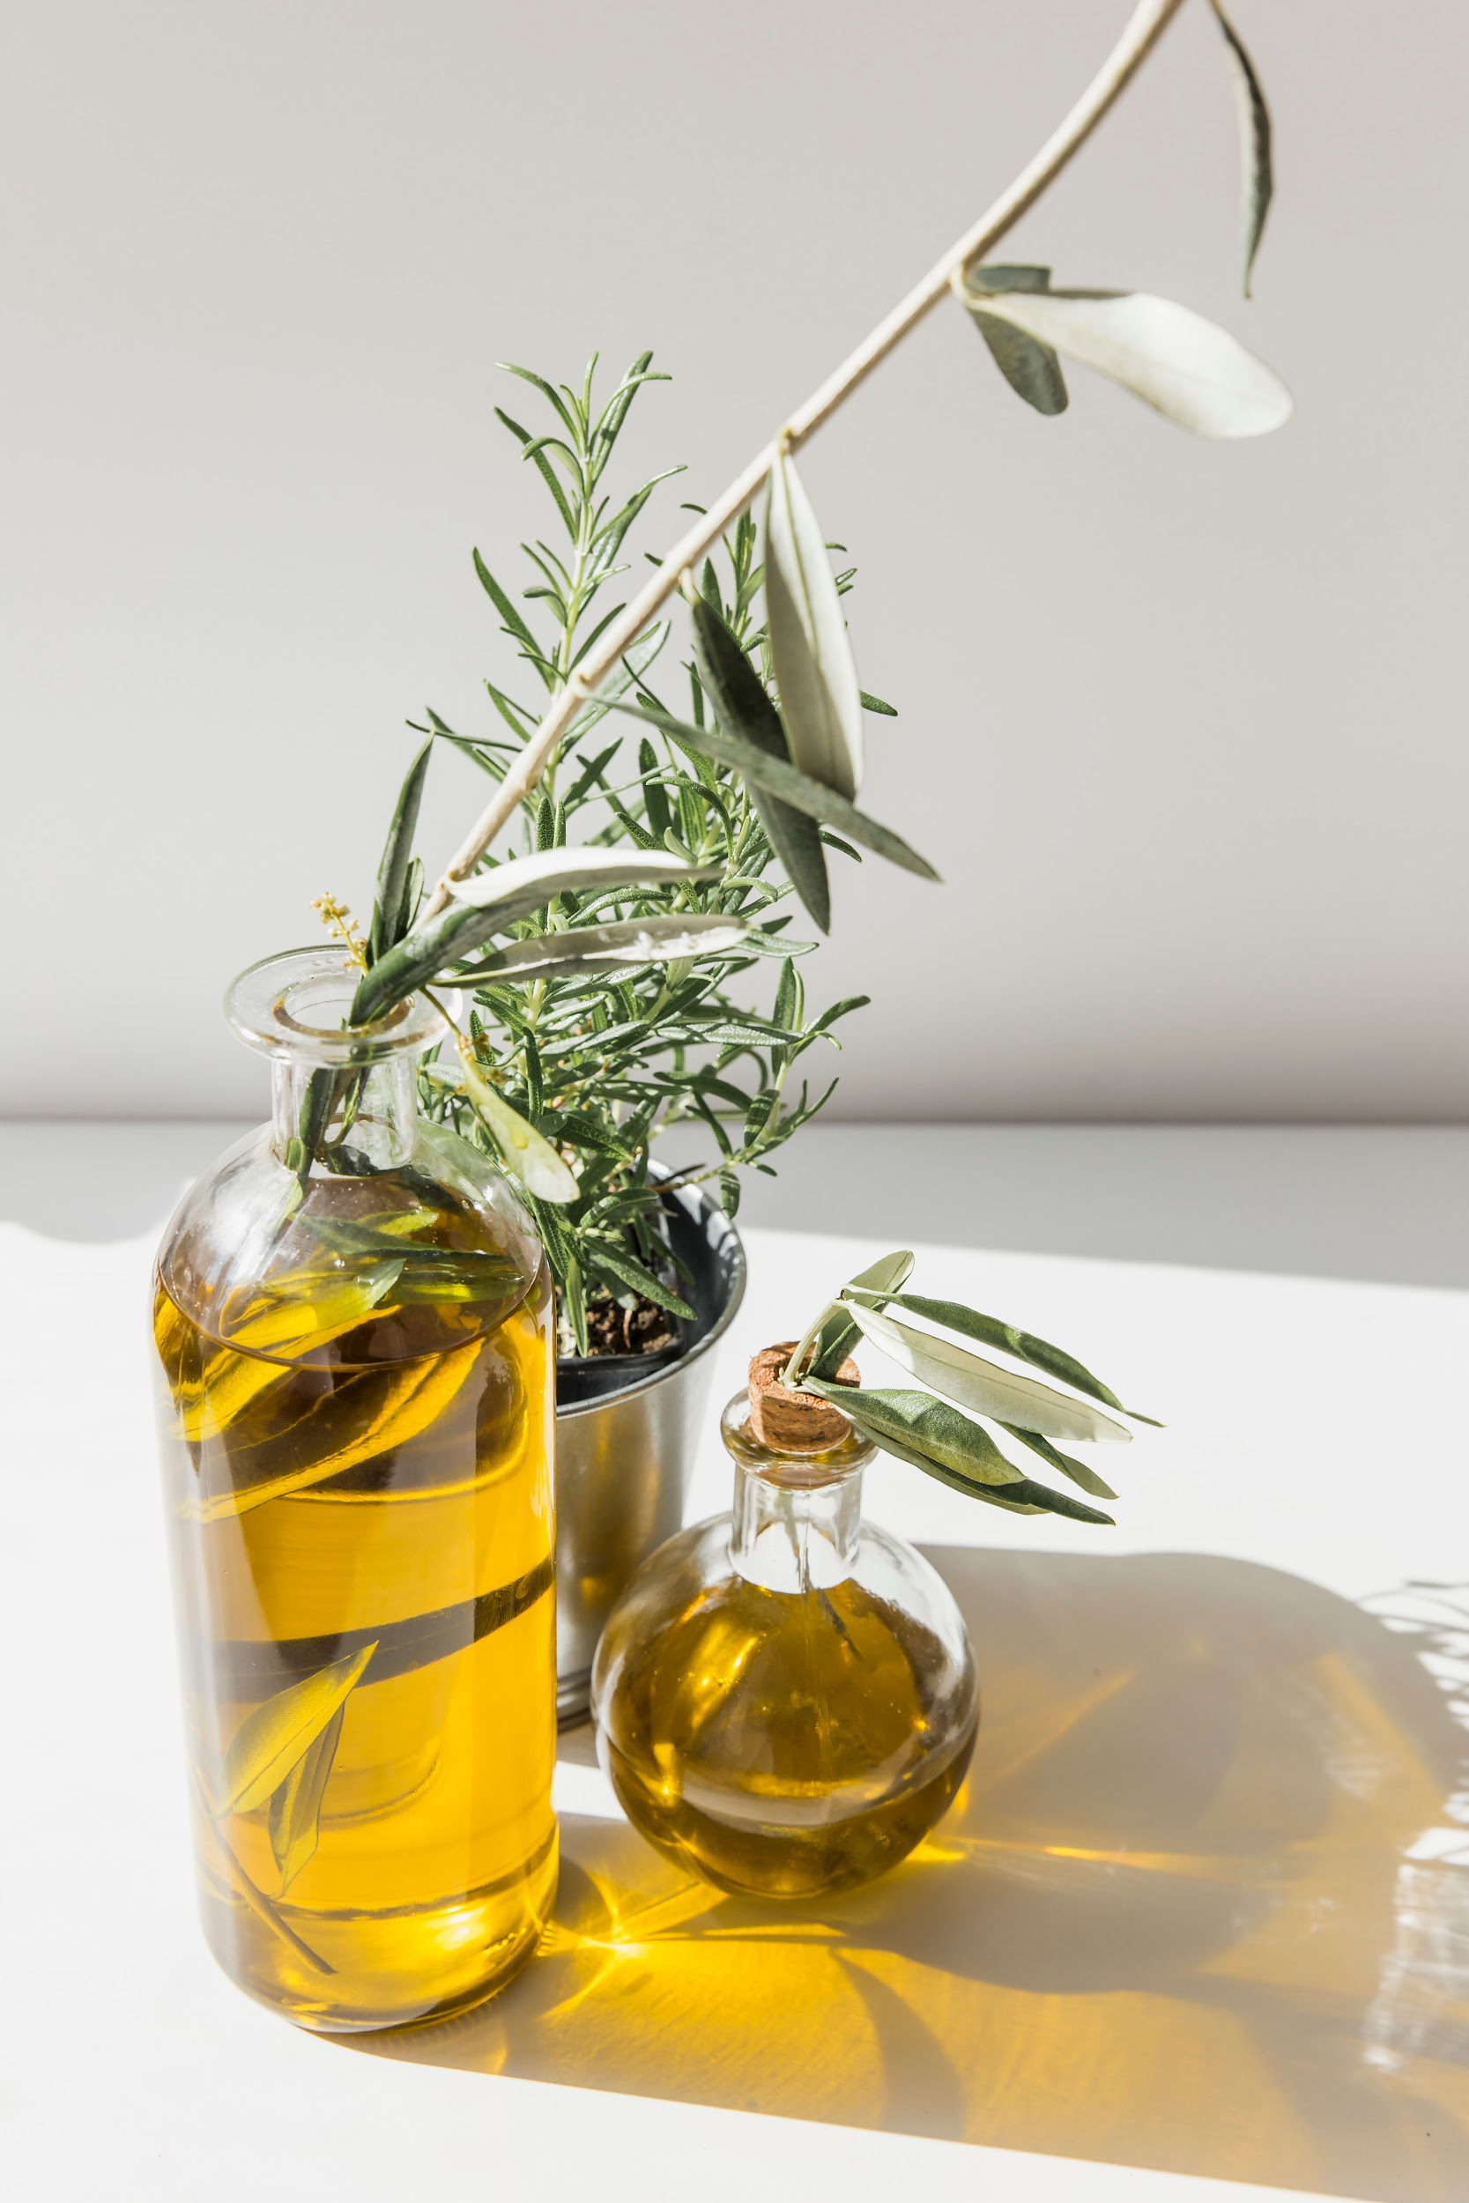
System Evaluation
To gauge the effectiveness of the proposed multimodal data fusion and XAI system, we will assess the disease identification model's accuracy, precision, recall, and F1 score.
We will evaluate the explainability of the AI model through appropriate metrics, ensuring the accuracy and meaningfulness of XAI.

Slide 6
Potential Challenges
Balancing model complexity with the need for explainability poses a challenge, especially with sophisticated Explainable AI techniques.
Ensuring the model's generalization in real-world agricultural settings is a significant challenge, given the variability in conditions.
Overcoming potential resistance to technology adoption and ensuring user understanding, particularly among farmers, is a critical challenge.
Adapting the system to function effectively in resource-constrained agricultural environments presents a practical challenge.

Slide 7
Future Statement
May be use more combinational model.
Could be use more classes and data.
Could be explore integrating real time monitoring capabilities through IoT devices for proactive and timely disease identification.
May be collaborate globally to access datasets so that to increase the model ability to identify plant disease.

Slide 8
Conclusion
In conclusion, we will use the dataset from Kaggle to train our model, while leveraging a diverse range of classes for heightened accuracy. By incorporating Multimodal Data Fusion and explainable Artificial Intelligence (XAI) features into our deep learning algorithm, we aim to enhance the model's prediction. This multifaceted approach sets the stage for a robust and insightful plant disease identification system.

Slide 9
Bibliography
El Mehdi Cherrat,Amine Saddik, Machine Learning Data Fusion for Plant Disease Detection and Classification, Fusion: Practice and Applications, Vol. 8 , No. 1 , (2022) : 39-49 (Doi : https://doi.org/10.54216/FPA.080104)
Yan Guo, Jin Zhang, Chengxin Yin, Xiaonan Hu, Yu Zou, Zhipeng Xue, Wei Wang, "Plant Disease Identification Based on Deep Learning Algorithm in Smart Farming", Discrete Dynamics in Nature and Society, vol. 2020, Article ID 2479172, 11 pages, 2020. https://doi.org/10.1155/2020/2479172
S. Ramesh et al., "Plant Disease Detection Using Machine Learning," 2018 International Conference on Design Innovations for 3Cs Compute Communicate Control (ICDI3C), Bangalore, India, 2018, pp. 41-45, doi: 10.1109/ICDI3C.2018.00017.

Slide 10


Thanks!
Do you have any questions?

